Slide 2
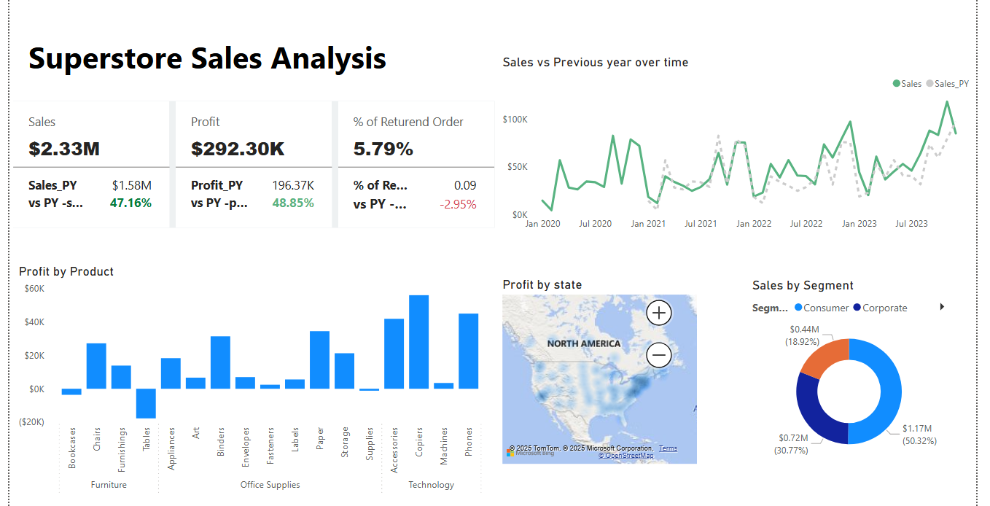

Slide 3
Number of return orders are less.
Tables are very less profitable.
Technology products are highest profitable.
Home office segment has minimum sales.

Slide 4
